Slide 1
SOA and Web Services

Slide 2
SOA
As we’ve seen, SOA is an architectural approach to building application systems where the focus is on a loosely coupled set of services which can be dynamically discovered and invoked.
In a SOA, software services are exposed over a network via well defined interfaces. This focus on the service interface abstracts the service requestor from the service implementation thereby promoting loose coupling.
As applications are integrated at the interface level (and not the implementation level), SOA increases flexibility as it allows applications to integrate with any implementation of the contract (interface).

Slide 3
SOA
The SOA approach to building IT systems is to align IT services with business services. The ultimate goal is to create a repository of IT services that can be orchestrated/composed into business processes quickly and easily using tools. This enables enterprises to react more quickly if market conditions change e.g. a business merger, a new supplier, outsourcing etc...
In an SOA, existing applications can be refactored and wrapped as services, to be consumed by existing or new applications. Thus, previous IT investments hidden away in legacy silos can be exposed as services and their logic reused and integrated into new applications.
Notes:
In the SOA approach, the designer is not building a software service for one purpose only; rather they are building a service that can potentially be used in many different business contexts. Enterprises no longer want their business functionality buried deep in a monolithic application which is difficult to integrate with. They want to abstract the business logic out into services so that these services can be invoked and re-used from a variety of locations and platforms.

Slide 4
SOA
The concept of SOA is not new. However, while the idea of separating the interface from its implementation to create a software service definition has been well proven in CORBA/RMI, the ability to completely separate a service description (into a text file) from its execution environment is new.
This allows us to mix and match services from different execution environments e.g. Java EE, .NET etc...
With SOA, the implementation environments of the services don’t matter; it’s the service that’s important.

Slide 5
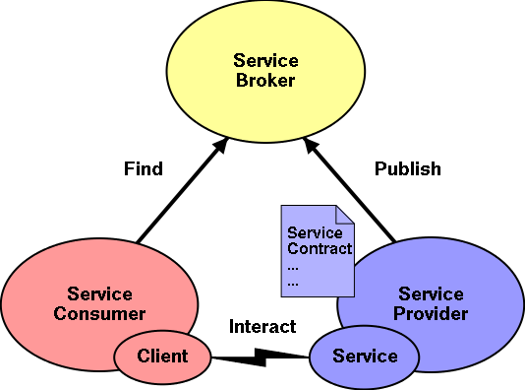
SOA Roles

Slide 6
SOA Roles
Service provider
  A service provider creates the service description. The service description is very important in an SOA because it describes everything the service requestor needs to know in order to invoke the service. The service provider deploys the service, makes it accessible over the network, publishes the service description in a registry and invokes the service when it receives service requests
Service requestor
  A service requestor must find the service description published in a service registry and then bind (execute or interact with) the service based on the description metadata.

Slide 7
SOA Roles
Service registry/broker
  The service registry is responsible for advertising service descriptions published to it by service providers and for allowing service requestors to search for services within the registry.
Service description/contract
  The key to SOA is the service description. The service description is published in the service registry by the service provider; the service description is what the service requestor “finds” and it is the service description that tells the service requestor everything it needs to know in order to bind to the service.

Slide 8
Web Services
Web Services are defined by the W3C as “a software system designed to support interoperable machine to machine interaction over a network”
Web services’ is one approach to implementing an SOA.
All that is required for (SOAP) Web services is that they can understand an XML-formatted request over a supported communications transport link (e.g. HTTP) and return an XML-formatted reply (if required).

Slide 9
Web Services
The major advantages of implementing an SOA with Web Services are that Web services are:
  interoperable - Applications can be built more quickly, leveraging on existing services by composing solutions based on them.
  pervasive – Web services default transport is HTTP which, because of the success of the Web, is ubiquitous
  simple – service descriptions and messages are plain text files
  platform-neutral – XML/JSON are by their nature platform and language neutral
  loosely coupled - thereby facilitating independent change
  firewall friendly - HTTP is firewall friendly so that external users can access internal Web servers

Slide 10
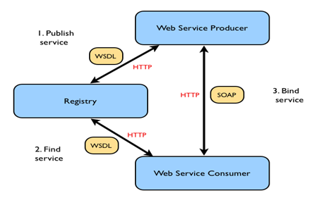
In the Web services architecture the provider publishes a WSDL description of the service in a UDDI (Universal Description, Discovery and Integration) registry. The requester accesses this UDDI registry, obtains the service description and executes the service by sending a SOAP message to the provider
WS-* Web Service Architecture

Slide 11
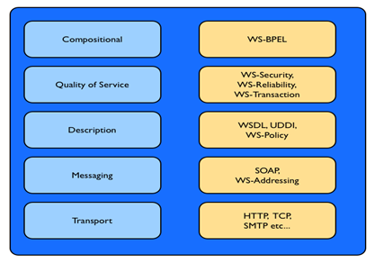
WS-* Interoperability Stack

Slide 12
Layer and Specifications | Protocols and Specifications
Compositional WS-BPEL | WS-BPEL (formerly BPEL4WS) is a standard to address how Web services can be composed or orchestrated into higher level business process workflows.
Quality of Service WS-Security, WS-Transactions WS-ReliableMessaging, | This layer contains specifications that deal with the quality of service of the Web services solution. At this layer, we are dealing with the capabilities and requirements of Web services with regard to reliable messaging, security and transactions.
Description WSDL, UDDI, WS-Policy | A service description is additional descriptive meta-data. With WSDL, programmers define the Functional characteristics of their Web services e.g. what operations does the service provide and what input/output messages are associated with those operations. WS-Policy is an approach to describing non-functional characteristics of a Web service. For example, logging, auditing etc.. Web services are published in registries. UDDI is the most widely acknowledged specification for Web registries. A complex specification, its adoption has been poor.
Messaging SOAP, XML, WS-Addressing, WS-Polling | At the messaging layer we have the core Web services technologies of XML, SOAP and WS-Addressing. XML is used for formatting the messages (SOAP) between requestor and provider and also for describing the services themselves (WSDL). SOAP was one of the original Web services standards. It defines an enveloping mechanism for Web services Messages. WS-Addressing standardizes the concept of response addresses i.e. where the response of the Web service should go.
Transports HTTP, HTTPS, SMTP etc.. | Web services are transport neutral (the default is HTTP).
WS-* Web Services Stack

Slide 13
How the stack works
All these WS-* standards can be intimidating but one must remember that Web services address a complicated problem: that of loosely coupled, dynamically configured, heterogeneous distributed computing.
Rather than deliver one massive specification, the community delivers a series of smaller, domain-specific specifications e.g. security, reliable messaging or transactions.
The individual specifications can be composed into an overall Web services system because each Web services specification is designed to integrate with the others.
For example, rather than WS-ReliableMessaging defining its own security standard, it will rely on WS-Security. One can therefore pick and choose the specifications that relate to your solution e.g. if security is not required then there is no need to use WS-Security

Slide 14
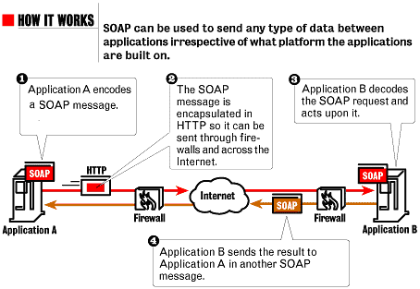
WS-* Web Services - SOAP
SOAP is simple, flexible and extensible; as it is XML based,
SOAP is programming-language, platform and hardware neutral.

Slide 15
The SOAP protocol
The SOAP protocol provides the following aspects:
  The SOAP Messaging Model - this is a mechanism for defining the unit of communication for SOAP messages. All information in a SOAP message is encapsulated within a SOAP envelope. The envelope has a body and any number of optional header sections.
  A processing model - this defines how SOAP messages are handled in software e.g. SOAP engines. It is particularly important when headers/extensions are involved.
  A mechanism for error handling - with SOAP faults, one can identify the source and cause of an error
  An extensibility model - SOAP headers are used to implement extensions on top of SOAP. For example, QoS features are implemented using SOAP headers.
  A protocol binding framework - bindings allow the transmission of SOAP messages over arbitrary underlying transports. The default is the ubiquitous HTTP transport.

Slide 16
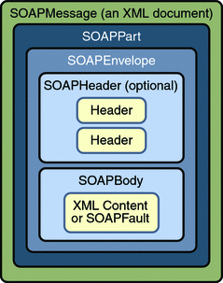
SOAP Message Structure
Envelope: The root element that defines the XML document as a SOAP message.
Header: Contains metadata for processing such as transactions and security (optional).
Body: Contains the call and response information.
Fault: Provides error handling information (optional).
https://docs.oracle.com/cd/E19316-01/819-3669/bnbhj/index.html

Slide 17
Sample SOAP Message
<?xml version="1.0"?>
<soap:Envelope
xmlns:soap="http://www.w3.org/2003/05/soap-envelope"
xmlns:m="http://www.example.org">
<soap:Header>
</soap:Header>
<soap:Body>
<m:GetPhoneNumber>
<m:firstName>Joe</m:firstName>
<m:lastName>Bloggs</m:lastName>
</m:GetPhoneNumber>
</soap:Body>
</soap:Envelope>
soap:Envelope is the root of the document in the http://schemas.xmlsoap.org/soap/envelope/ namespace.
The SOAP envelope contains optional headers and a mandatory body section. The headers allow vertical
extensibility (discussed later). The soap:Body surrounds the Web service to be executed and the parameters to be passed in. In this case, we are invoking a Web service called GetPhoneNumber which, when passed a first name and a surname, returns that person's phone number.

Slide 18
SOAP response msg
A sample SOAP message response to the request on previous slide
<?xml version="1.0"?>
<soap:Envelope
xmlns:soap="http://www.w3.org/2003/05/soap-envelope"
xmlns:m="http://www.example.org">
<soap:Header>
</soap:Header>
<soap:Body>
<m:GetPhoneNumberResponse>
<m:PhoneNumber>0871234567</m:PhoneNumber>
</m:GetPhoneNumberResponse>
</soap:Body>
</soap:Envelope>

Slide 19
SOAP Headers (vertical extensibility)
The optional header section is how SOAP achieves message extensibility. The headers (if present) appear before the body section.
Because the headers sit on top of the message, it is termed “vertical extensibility”.
The headers are used to achieve QoS: for example, security, reliability and transactionality

Slide 20
Vertical Extensibility – WS-Security
Message Integrity: achieved by using digital signitures – allows the receiver to verify that the message hasn’t been altered.
Message Confidentiality: uses encryption to protect the contents of the message from being read by intermediaries.
Authentication: provides mechanisms to verify username/password credentials.

Slide 21
Vertical Extensibility –
WS-ReliableMessaging
WS-ReliableMessaging used for guaranteed delivery of messages
Handles message retries and acknowledgements
Useful in error-prone networks

Slide 22
SOAP Intermediaries (horizontal extensibility)
Whereas vertical extensibility is about introducing new information into a SOAP message, horizontal extensibility is about targeting different parts of the same SOAP message to different recipients.
This leads us to SOAP intermediaries…
SOAP intermediaries are applications that can process a SOAP header specifically targeted at it, as the SOAP message travels from source to destination.

Slide 23
SOAP Intermediaries (horizontal extensibility)
Intermediaries are useful in several situations :
  Securing message exchange through untrustworthy domains - this can be done by sending the message first to an intermediary that would first encrypt and then digitally sign the message. On the receiving end an intermediary would do the opposite - check the digital signature and if ok, decrypt the message.
  Nonrepudiation - used to make a record of a transaction (so that the transaction cannot be later repudiated/denied by either party). Instead of sending the message directly to the receiver, the sender sends it to the intermediary who makes a persistent copy of the request and then sends it on to the receiver.
  Message tracing facilities - this allows a message recipient to trace the message route, complete with timings of arrivals and departures to and from intermediaries. This information is very useful for measuring quality of service and identifying bottlenecks.

Slide 24
SOAP Faults
To signify that an error has occurred, a SOAP fault is generated. This is much like an exception in Java. A SOAP fault is a normal SOAP message except that you have the Fault as the main element inside the Body. Here is an example:
<soap:Envelope xmlns:soap="http://www.w3.org/2003/05/soap-envelope"
xmlns:m="http://www.example.org">
<soap:Body>
<soap:Fault>
<soap:Code>
<soap:Value>InvalidPurchaseOrder</soap:Value>
</soap:Code>
<soap:Reason>
<soap:Text>Purchase Order failed validation</soap:Text>
</soap:Reason>
<soap:Detail>
<m:LineNumber>9</m:LineNumber>
<m:ColumnNumber>24</m:ColumnNumber>
</soap:Detail>
</soap:Fault>
</soap:Body>
</soap:Envelope>

Slide 25
SOAP Faults
A SOAP Fault element, contains a Code element, followed by a Reason element followed by a Detail element.
The Code element outlines the general issue.
The Reason element contains a human-readable description of the error.
The Detail element contents depends on the SOAP server implementation i.e. the server can insert any information necessary to help the client further understand the cause of the fault. In the previous slide, the contents reflect the line and column numbers of where validation had an issue with the request document.

Slide 26
Web Services Description Language (WSDL)
WSDL is the Interface Definition Language (IDL) for Web services. A WSDL description has three essential pieces of information:
  the service signature - the operations (methods) the service provides, and the data passed (arguments and returns)
  how to access the service - the transport protocols to be used e.g. SOAP via HTTP
  where the service is located - the protocol specific network address of the endpoint hosting the Web service e.g a URL
A WSDL document must conform to the XML Schema defined for the WSDL language defined at http://schemas.xmlsoap.org/wsdl/2003-02-11.xsd.

Slide 27
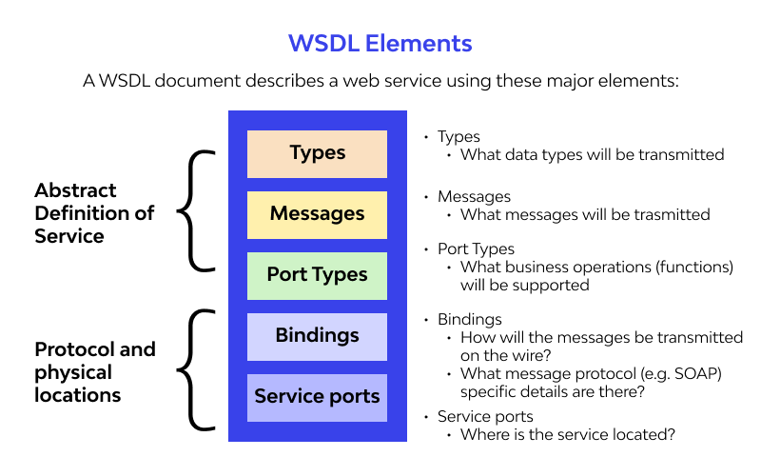
WSDL Elements
https://www.wallarm.com/what/what-is-web-services-description-language-wsdl

Slide 28
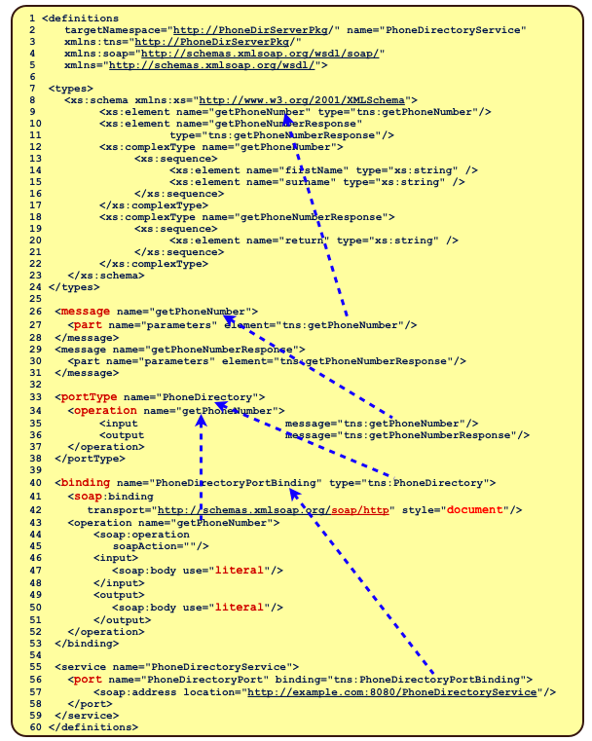

Slide 29
Description of previous service
The sample WSDL file describes an example service called PhoneDirectoryService (line
57). Note that the default namespace is the WSDL namespace
i.e. “http://schemas.xmlsoap.org/wsdl/”.
The service contains one port element that refers to the PhoneDirectoryPortBinding.
The port’s soap:address gives us the endpoint location of where to send our messages.
The binding PhoneDirectoryPortBinding (line 40) binds to the portType
PhoneDirectory (line 33). PhoneDirectoryPortBinding states that the
messaging/transport protocol is SOAP/HTTP (line 42) and that the style of messaging is
document-style (line 42).
One operation is defined in the binding, namely getPhoneNumber. This operation defines
both an input and output message. These messages are literal messages i.e. their contents
are XML elements. The portType PhoneDirectory, referred to from the binding, defines
an abstract operation namely getPhoneNumber, with an input and output message (in that
order). These messages (getPhoneNumber and getPhoneNumberResponse) are defined
using part elements. The parts are defined in the XML schema types section
getPhoneNumber (the input) is defined as consisting of two XML strings and
getPhoneNumberResponse (the output) is also an XML string.

Slide 30
WSDL
definitions element
  The definitions element is the root of a WSDL document. It defines the namespaces to be used and their associated prefixes.
types element
  The types section is essentially a place where user-defined XML types and elements can be specified for later use from parts elements.
message element
  This is a construct that outlines the abstract format of an input, output or fault message. The messages defined are referred to from the operation section.

Slide 31
WSDL
portType element
  This is the element that abstractly defines the interface of the Web service.
  It is similar to a Java interface in that it specifies what operations (methods in a Java interface) are available.
operation element
  An operation in WSDL is equivalent to a method signature in Java. An operation defines a method on a web-service, including the name of the method and the input parameters and return type.

Slide 32
WSDL
binding element
  The binding element tells a requestor how to invoke operations using a particular messaging/transport protocol e.g. SOAP/HTTP. For example, if a message is to be sent using SOAP over HTTP, the binding describes how the message parts are mapped to elements in the SOAP <Body>.
  The binding element structure is very similar to the portType element – this is no coincidence as the binding is the implementation of the portType.
  The type attribute (of the binding element) identifies which portType a binding relates to.

Slide 33
WSDL
service element
  The service element takes the binding element(s) defined previously and ties them to one or more port elements.
  A port element, which is a sub-element of service, is a single endpoint defined as a combination of a binding and a network address.
  A port element defines the location e.g. a URL, at which the operations of a specific portType, using a particular transport protocol, can be invoked.

Slide 34
Advantages of SOAP
Strongly typed messaging system.
Independent of transport protocol (HTTP, TCP, etc.).
Extensive pre-defined standards for a wide range of applications.
  Security
  Reliable Messaging
  Transactions

Slide 35
Disadvantages with SOAP
Verbose message format can lead to larger sizes, and slower communications.
Can be complex to implement and manage.
May be overkill for simple applications.
More difficult to deal with in client web applications

Slide 36
Use Cases of SOAP
Any application area where Security, Reliability or Transactions are important. E.g.
  Enterprise application integration.
  Financial services.
  Telecommunications.
  Healthcare information exchange.

